Slide 1




Ecommerce Clickstream
SIC 8
BD Course
G 13
Notes:
Note:
1

Slide 2
Agenda
Team
Introduction
Problem Statement
Methodology
Key Tasks
Results and Insights
Conclusion
Q&A
Samsung Innovation Campus
Notes:
Note:
2

Slide 3

Team members
  Basel Mamdouh Elgendy
  Omar Mahmoud Ismail
  Omar Abdelhamed Ahmed
  Adham Mohamed Mahdy
Samsung Innovation Campus
Notes:
Note:
4

Slide 4
Agenda
Team
Introduction
Problem Statement
Methodology
Key Tasks
Results and Insights
Conclusion
Q&A
Samsung Innovation Campus
Notes:
Note:
3

Slide 5
Introduction
E-commerce clickstream data is critical for understanding customer behavior, conversion, and revenue growth.
Every day, online retailers rely on accurate, real-time information to answer questions like:
  What is the average session duration, and how many customers return the next day?
  What is the daily conversion rate from product view to purchase?
  Which products have the highest cart abandonment rate?
  How does revenue change by product category, customer segment, and date?
Yet, despite millions of customer events generated every day, turning raw clickstream data into actionable insights remains a major challenge due to inconsistent formats, duplicate and late-arriving events, and the need for real-time analysis.
This project delivers a modern Clickstream Pipeline on Microsoft Fabric that transforms raw customer events into a scalable, automated, and analytics-ready environment.
Samsung Innovation Campus
Notes:
Note:
4

Slide 6
Agenda
Team
Introduction
Problem Statement
Key Tasks
Methodology
Results and Insights
Conclusion
Q&A
Samsung Innovation Campus
Notes:
Note:
5

Slide 7

Problem Statement
Online stores generate millions of customer events every day, but this data arrives as a raw, mixed, and unreliable stream that is not designed for analysis.
This makes it difficult for organizations to answer key business questions such as:
  Where do customers drop off, and which carts are abandoned?
  What is the daily conversion rate from product view to purchase?
  Which products and categories drive the most revenue?
  How long do sessions and checkouts take?
Because the stream has no analytical structure, analysts must deal with:
  Every event type mixed in one table, with nested JSON payloads
  Duplicate, late, and out-of-order events that inflate or distort metrics
  Dirty values: nulls, wrong casing, numbers stored as text, unknown IDs
  Manual rebuilding of sessions, funnels, and order-to-product links
Samsung Innovation Campus
Notes:
Note:
6

Slide 8
Agenda
Team
Introduction
Problem Statement
Methodology
Key Tasks
Results and Insights
Conclusion
Q&A
Samsung Innovation Campus
Notes:
Note:
7

Slide 9







Methodology
Our methodology implements an end-to-end streaming pipeline on Microsoft Fabric. A Python generator sends live and historical events through an Eventstream into an Eventhouse, where the raw Bronze data is mirrored to OneLake. Spark cleans and deduplicates it into Silver, models it as a Gold star schema, and serves it to Power BI dashboards.
Python generator
Live + history
Eventstream
Kafka endpoint
Eventhouse
Bronze: raw_events
mirrored to OneLake, then
Power BI
Dashboards
Gold
Galaxy schema
Spark
Silver: clean, dedup

Slide 10
Agenda
Team
Introduction
Problem Statement
Methodology
Key Tasks
Results and Insights
Conclusion
Q&A
Samsung Innovation Campus
Notes:
Note:
8

Slide 11
Data Ingestion
Data Ingestion: Real-Time Clickstream Pipeline
Flow: Python Generator → Fabric Eventstream → Fabric Eventhouse
Data Source
  Synthetic e-commerce activity: browsing, carts, payments and orders
Ingestion Process
  Generate: a Python producer simulates realistic user sessions
  Validate: every business rule is verified before any data is ingested (10 checks, 0 failures)
  Stream: events are published to a Fabric Eventstream over a Kafka endpoint
  Land: raw events are stored in the Eventhouse, then automatically split into 11 typed tables
Why Streaming
  Customer activity is continuous, not batch-based
  Supports near real-time dashboards and operational monitoring
  Historical backfill plus live stream through one pipeline
Technologies: Python · Kafka protocol · Fabric Eventstream · Fabric Eventhouse · KQL

Slide 12
Data Transformations
Exploratory Data Analysis (EDA)
Catalog · 4 tables
Customers · 2 tables
Shopping funnel · 5 tables
Tracking · 3 tables
categories
6
customers
≈5.6K
cart_items
≈6.5K
clickstream_events
≈259K
products
≈2.0K
devices
≈8.9K
cart_removals
≈0.6K
event_types
11
product_prices
≈2.1K
checkouts
≈2.3K
calendar_days
761
stock_changes
≈3.1K
payment_attempts
≈1.9K
orders
≈1.8K
Scale
Shape
618,134 rows in 14 tables; clickstream and events hold 93% of them.
105 columns in total; clickstream is the widest (22)
Silver Layer

Slide 13
Data Transformations
Cleaning Rules and Their Effect
Rule
Applies to
Effect on the data
Trim whitespace
All string columns, all 14 tables
Value normalized, row stays valid
Schema guard
Required columns of each table
Missing column stops the run
Missing required value
event_id, event_ts, session_id, product_id, price
Row goes to invalid
Negative value
price, amount, list_price, stock_quantity
Row goes to invalid
Non-positive quantity
quantity on cart items, checkouts, orders
Row goes to invalid
Duplicate key
event_id, category_id, date_key, event_type_id
First kept, later rows invalid
Optional clickstream fields
price, quantity, amount, cart_value, order_value
Null allowed, row stays valid
Silver Layer

Slide 14
Data Transformations
Incremental Run
1
2
3
4
Read
Clean
Write
Finish
readStream on raw.<table> (Delta), one query per table
foreachBatch runs the cleaner, then flag_duplicates
save_batch appends to the valid and invalid tables
availableNow stops after new data; awaitTermination surfaces errors
Checkpointing
Correctness
  One checkpoint per table under Files/_checkpoints/silver_tablewise_<version>
  Missing checkpoint or Silver table: both reset, table reprocessed from the first row
  Duplicates flagged inside the batch and against keys already in valid
  Final check: valid + invalid must cover raw rows; failure routes to Fail_Silver
Silver Layer

Slide 15
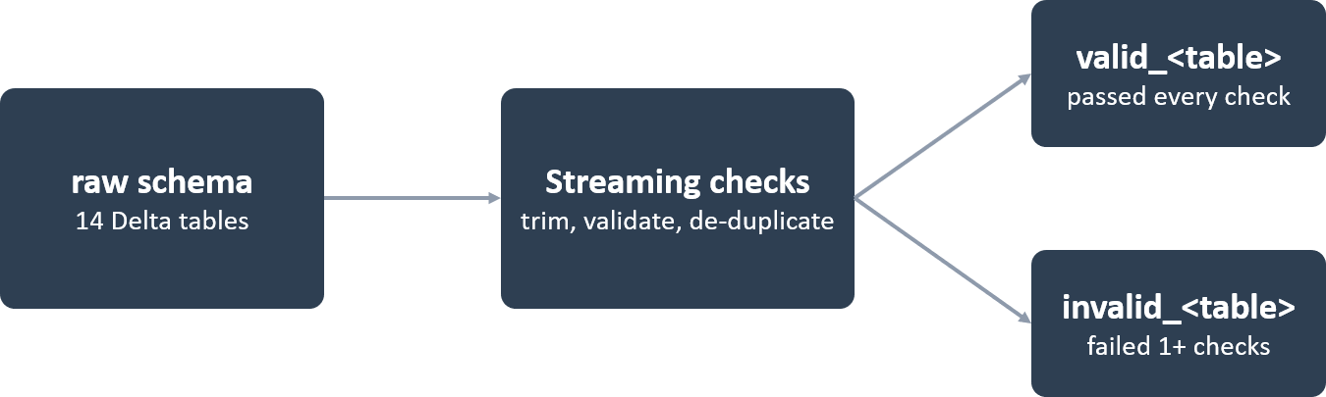
Data Transformations
Valid & Invalid
silver.valid_<table>
silver.invalid_<table>
  Rows that passed every check
  First occurrence of each key is kept
  Rows that failed at least one check
  Adds validation_reason, source_table, processed_ts
  Later duplicates of a key land here
Silver Layer

Slide 16
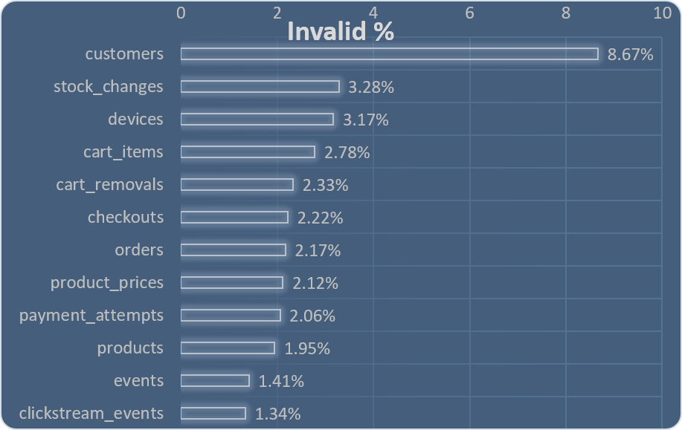
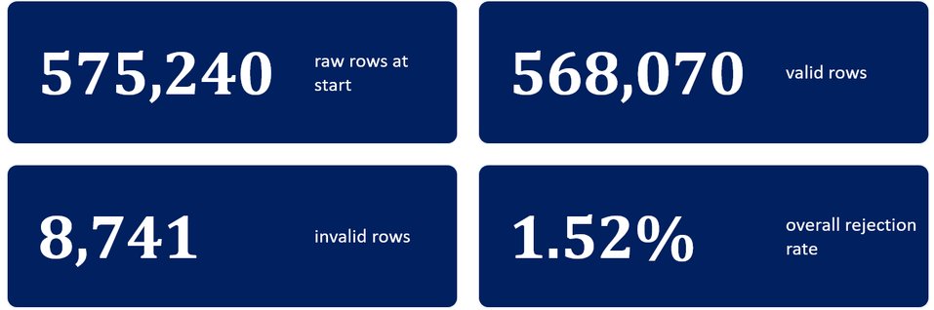
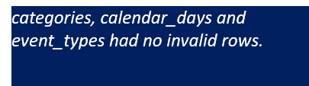
Data Transformations
Run results:
Silver Layer

Slide 17

Data Modeling
Gold Layer – Galaxy Schema
Transforms validated Silver data into fact and dimension tables designed around clickstream behavior and e-commerce activity
Implements a Galaxy Schema, connecting multiple fact tables FACT_EVENTS, FACT_SESSIONS, and FACT_ORDERS through shared dimensions for customers, products, devices, event types, and dates.
Business KPIs, including conversion rate and cart abandonment rate, are calculated as Power BI measures to remain responsive to report filters
Outcome
A business-ready analytical layer that connects customer interactions to sessions, carts, and orders, enabling consistent KPI reporting and interactive Power BI dashboards.

Slide 18
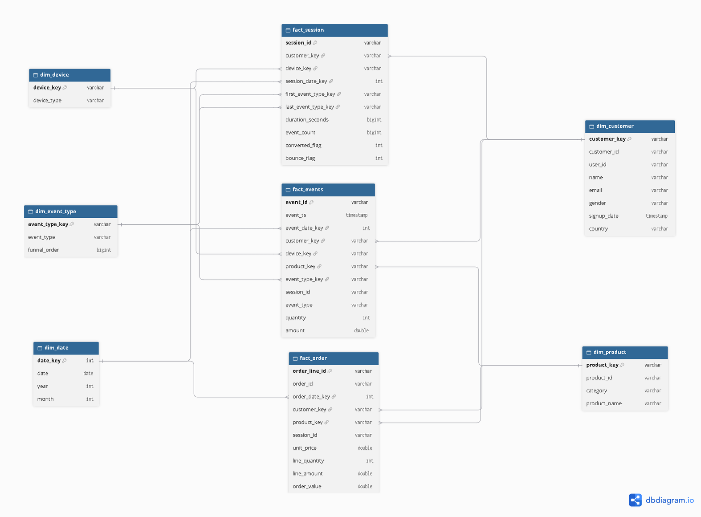
Galaxy Schema:

Slide 19
Data Quality
  Completeness & Validity: Validated required event fields from null/missing values, event type formats, and expected event types.
  Uniqueness & Referential Integrity: Checked duplicate business keys and verified references between clickstream events and related entities.
  Timeliness & Freshness: Monitored late arriving events, ingestion lag (P95), and data freshness
  Automated Quality Scorecard: Evaluated Silver and Gold outputs, reporting validation results, warnings, failures, and informational checks.
91.8% Quality Score · 112 PASS · 10 WARN · 0 FAIL · 59 INFO
The scorecard provides visibility into data quality across the pipeline, helping identify issues before they affect downstream analytics.

Slide 20
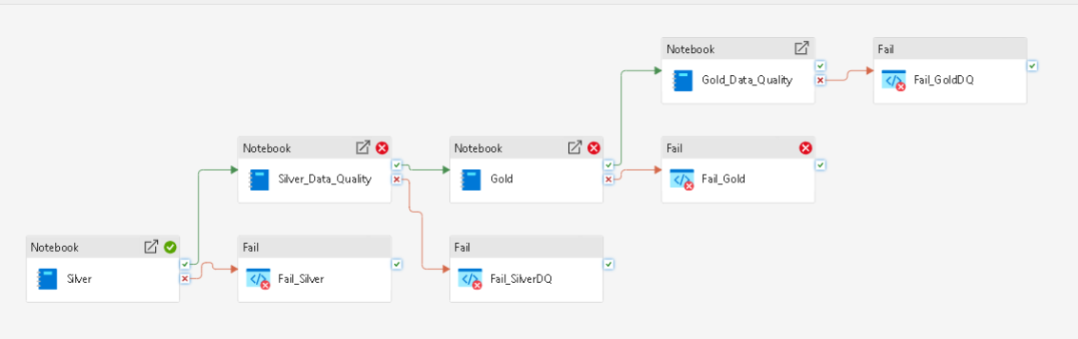
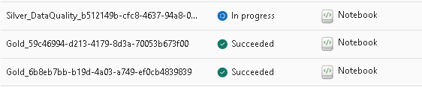
Data orchestration and Monitoring
Orchestration & Monitoring
Pipeline Orchestration
  Coordinates data processing across Bronze, Silver, and Gold layers.
Data Quality
  Monitors validation results, failed checks, and quarantined records.
Reliable Processing
  Supports troubleshooting and recovery when processing fails.
Outcome: Better pipeline visibility and more reliable analytics.
,

Slide 21
Agenda
Team
Introduction
Problem Statement
Methodology
Key Tasks
Results and Insights
Conclusion
Q&A
Samsung Innovation Campus
Notes:
Note:
8

Slide 22
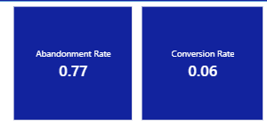
Results and insights
Conversion rate (6%) is orders divided by sessions. Out of about 33K visits, only about 2K ended in a purchase. About 94% of visits ended with no order.
Abandonment rate (77%) is cart additions that didn’t become orders. Of every 100 times a customer put something in the cart, only about 23 ended in a purchase.
About 1 in 4 visits shows buying intent by adding an item to the cart, but fewer than 1 in 4 of those carts become an order. The store attracts interested customers. It loses them at checkout. Closing even a small part of that gap is the fastest way to grow revenue.

Slide 23
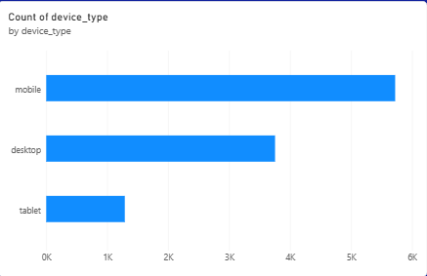
Results and insights
mobile has the most activity, then desktop, then tablet.

Slide 24
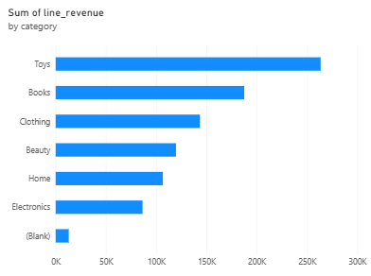
Results and insights
Toys (about 260K) and Books (about 185K) lead. Electronics is last (about 85K).
  Prioritize Toys and Books in homepage placement, ads and stock.
  For Electronics, find out why it lags. It may be pricing, a thin range, or low traffic, so check its views against its purchases before cutting or promoting it.

Slide 25
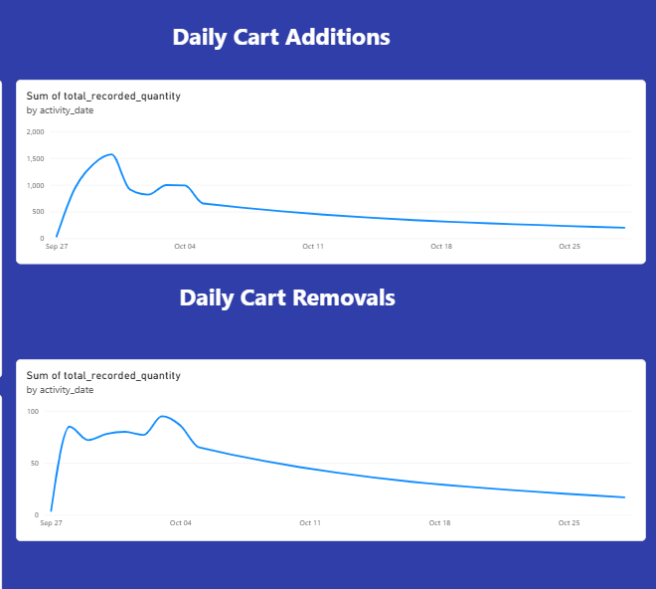
Results and insights
The first-week spike probably came from a launch, campaign, or promotion, and nothing replaced it afterwards.
Shopping intent fell sharply after the first week. Fewer customers are adding items to the cart each day
  Find out why items get removed. Break removals down by product and category. If a few products drive most removals, check their price, stock status, delivery time, or reviews.
  Reduce removal triggers. Show shipping cost and delivery date on the product page and in the cart, and send a “price drop / back in stock” message for removed items.

Slide 26
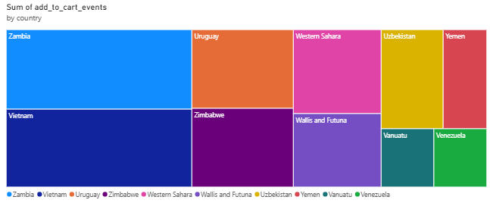
Results and insights
Zambia and Vietnam dominate. Together they take up roughly half of the chart’s area, so they generate about half of the cart activity among these ten countries.

Slide 27
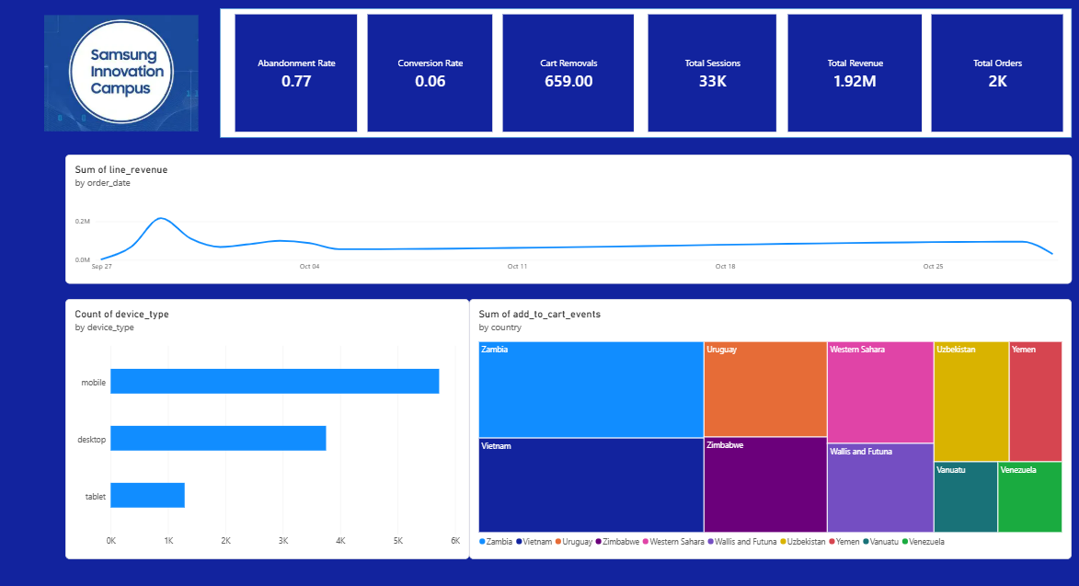
Results and insights

Slide 28
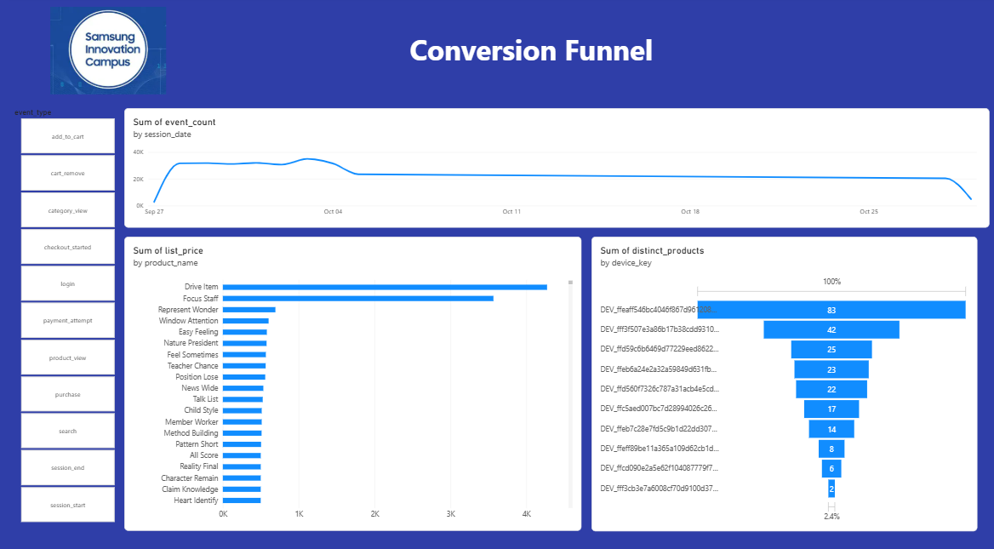
Results and insights

Slide 29
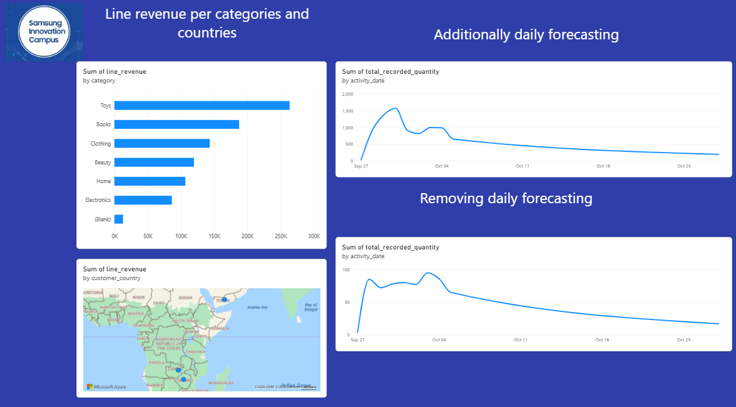
Results and insights

Slide 30
Agenda
Team
Introduction
Problem Statement
Methodology
Key Tasks
Results and Insights
Conclusion
Q&A
Samsung Innovation Campus
Notes:
Note:
8

Slide 31

Business Insights & recommendations
1. Only 6% of sessions convert, and 77% of carts are abandoned
→ Recover carts with reminder emails and simplify checkout (guest checkout, fewer steps).
2. Mobile is the most-used device
→ Optimize mobile checkout with saved payment and wallet options.
3. Toys and Books lead revenue, Electronics lags
→ Prioritize stock and promotions for Toys and Books, and investigate Electronics.
4. Zambia and Vietnam drive the most cart activity, but only Zambia clearly turns it into revenue
→ Investigate payment and shipping barriers in Vietnam.
5. Cart additions fell sharply after the first week
→ Run re-engagement campaigns after launch spikes.

Slide 32

Thank you
ⓒ2020 SAMSUNG. All rights reserved.
Samsung Electronics Corporate Citizenship Office holds the copyright of book.
This book is a literary property protected by copyright law so reprint and reproduction without permission are prohibited.
To use this book other than the curriculum of Samsung innovation Campus or to use the entire or part of this book, you must receive written consent from copyright holder.
Notes:
10

